Slide 1
Introduction to Auto ML with ML.NET 1.0
Place name here
Notes:
@ankitasthana86 480
@cesardelatorre 2845
@clauren42 154

Slide 2
ML.NET Proven in Community

Slide 3


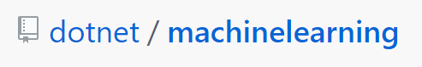
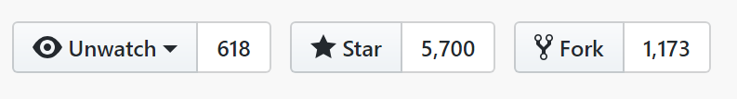
150K+
Downloads
ML.NET Open Source Momentum
1,427
Commits
1,528
Pull requests
106
Contributors

Slide 4








“ML.NET made it straightforward to leverage our existing .NET and C# skills and software assets to add machine learning capabilities into the application… deployed on Azure, the integration of machine learning models was easy and straightforward.”
Andy Gray, Executive Partner Evolution Software Design, Inc.
+ more ML.NET Customers
Notes:
Our customers have been embracing the productivity in our platform, languages and tools for 15+ years. We’re now gaining existing customers as well as new ones on our cloud-native, cross-platform, and device-native approaches with these new architectures. Here are just a few. There are many more (and their stories) on our website.

Slide 5
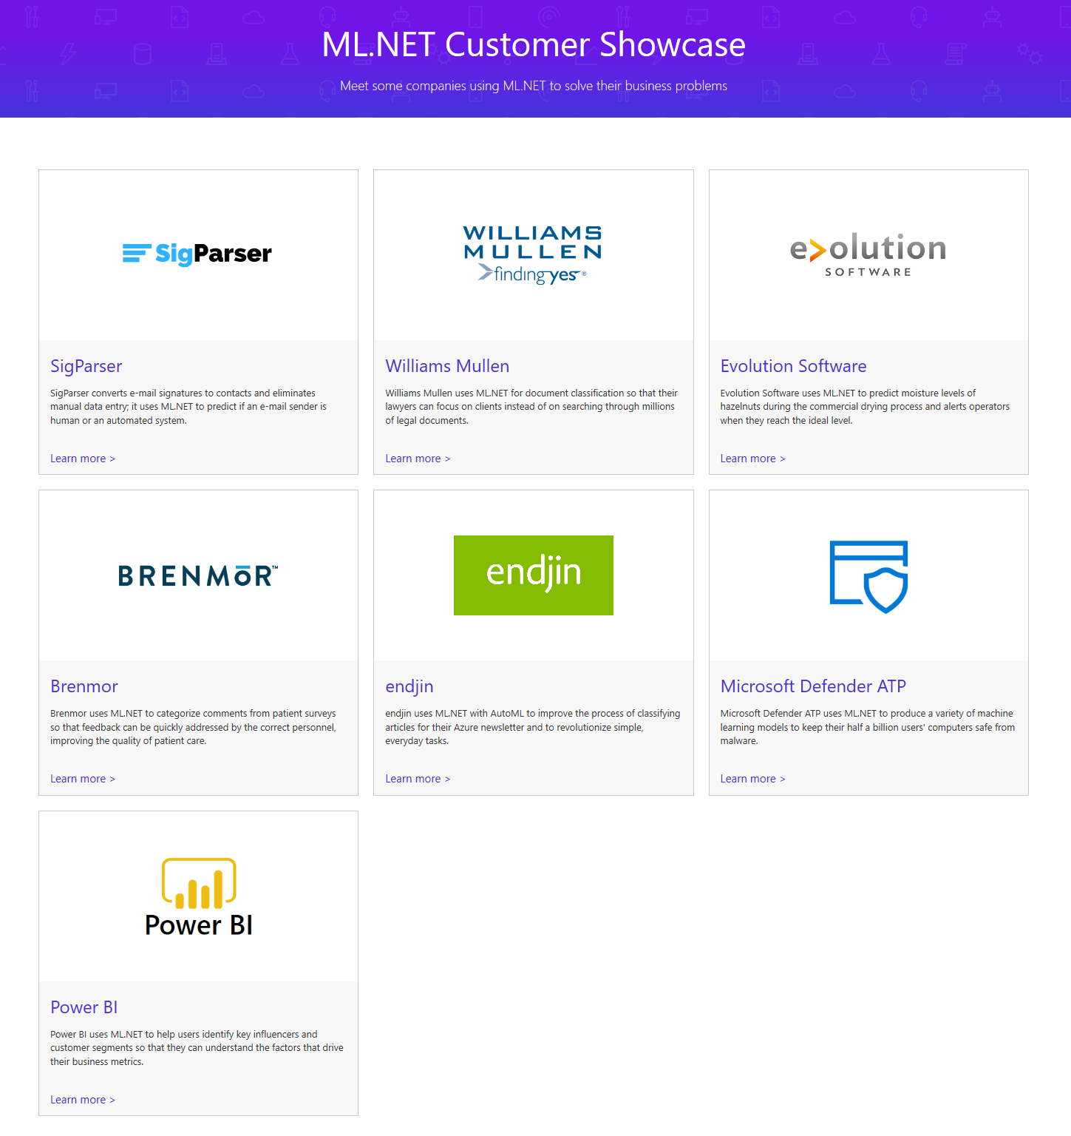
https://dotnet.microsoft.com/apps/machinelearning-ai/ml-dotnet/customers

Slide 6
ML.NET Features

Slide 7














Your platform for building anything
DESKTOP
WEB
CLOUD
MOBILE
GAMING
IoT
ML
.NET
Notes:
.NET is a great tech stack for building a wide variety of applications. There is ASP.NET for web development, Xamarin for mobile development and with ML.NET we are trying to make .NET great for Machine Learning.

Slide 8

Machine Learning “Programming the UnProgrammable”
{
{
Is this a face?
Price of Shirt?
f(x)
f(x)
“It has exquisite buttons … with long sleeves …works for casual as well as business settings”

Slide 9



Machine Learning “Programming the UnProgrammable”
{
Machine Learning creates a
Face
Face
f(x) Model
Not a face
Not a face
using this data
Notes:
A model is an intelligent function which can predict

Slide 10

ANNOUNCED @ Build2019
ML.NET 1.0 @Build 2019
ML.NET 1.0
Machine Learning framework for building custom ML Models Custom ML made easy Automated ML and Tools (Model Builder and CLI) Proven at scale Azure, Office, Windows
Extensible TensorFlow, ONNX and Infer.NET Cross-platform and open-source Runs everywhere

Slide 11
Case for Automated ML

Slide 12
Building blocks for a Data Science Project
Build and train models
Hyperparameter tuning
Experimentation and pipelines
Deployment
DevOps for data science
Classical ML
Data sources
Deep learning

Slide 13

What is automated machine learning?
Automated machine learning (automated ML) automates feature engineering, algorithm and hyperparameter selection to find the best model for your data.

Slide 14



Automated ML Mission
Enable automated building of machine learning with the goal of accelerating, democratizing and scaling AI
Democratize AI
Accelerate AI
Scale AI
Enable Domain Experts & Developers to get rapidly build AI solutions
Improve Productivity for Data Scientists, Citizen Data Scientists, App Developers & Analysts
Build AI solutions at scale in an automated fashion
Notes:
Once you have your data source and format defined. You need to consider how you want the experiment to split your train, test and validation data. Automated ML supports three types.
K-fold
Monte Carlo or repeated random sub-sampling
Manual or custom splits.
K-Fold
For k-fold use n_cross_validations setting to specify the number of cross validations. The training data set will be randomly split into n_cross_validations folds of equal size. During each cross-validation round, one of the folds will be used for validation of the model trained on the remaining folds. This process repeats for n_cross_validations rounds until each fold is used once as validation set. The average scores across all n_cross_validations rounds will be reported, and the corresponding model will be retrained on the whole training data set.
Monte Carlo
Use validation_size to specify the percentage of the training dataset that should be used for validation, and use n_cross_validations to specify the number of cross validations. During each cross validation round, a subset of size validation_size will be randomly selected for validation of the model trained on the remaining data. Finally, the average scores across all n_cross_validations rounds will be reported, and the corresponding model will be retrained on the whole training data set.
Custom Validation Dataset
Use custom validation if random split is not acceptable (usually time series data or imbalanced data). You can specify your own validation dataset. The model will be evaluated against the validation dataset specified instead of random dataset. If you are using custom splits you split you would split your data based on your requirements and pass your training data into the x and y parameters and x_valid and y_valid for validation data.

Slide 15
Machine Learning Problem Example
How much is this car worth?

Slide 16
Model Creation Is Typically Time-Consuming
Which features?
Which algorithm?
Which parameters?
Mileage
Condition
Car brand
Year of make
Regulations
…
Gradient Boosted
Nearest Neighbors
SVM
Bayesian Regression
LGBM
…
Parameter 1
Parameter 2
Parameter 3
Parameter 4
…
Mileage
Gradient Boosted
Criterion
Loss
Min Samples Split
Min Samples Leaf
Others
Car brand
Year of make
30%
Model

Slide 17
Model Creation Is Typically Time-Consuming
Which features?
Which algorithm?
Which parameters?
Mileage
Condition
Car brand
Year of make
Regulations
…
Gradient Boosted
Nearest Neighbors
SVM
Bayesian Regression
LGBM
…
Criterion
Loss
Min Samples Split
Min Samples Leaf
Others
Mileage
Gradient Boosted
N Neighbors
Weights
Metric
P
Others
Condition
Nearest Neighbors
Car brand
Car brand
50%
Year of make
30%
Year of make
Model
Iterate

Slide 18
Model Creation Is Typically Time-Consuming
Which features?
Which algorithm?
Which parameters?
30%
50%
70%
30%
45%
50%
65%
95%
35%
10%
75%
20%
70%
30%
15%
Iterate

Slide 19
Automated ML Accelerates Model Development
Input
Intelligently test multiple models in parallel
Output
25%
Optimized model
25%
40%
Enter data
70%
25%
40%
70%
95%
95%
Define goals
25%
40%
70%
25%
40%
25%
70%
Apply constraints
40%

Slide 20
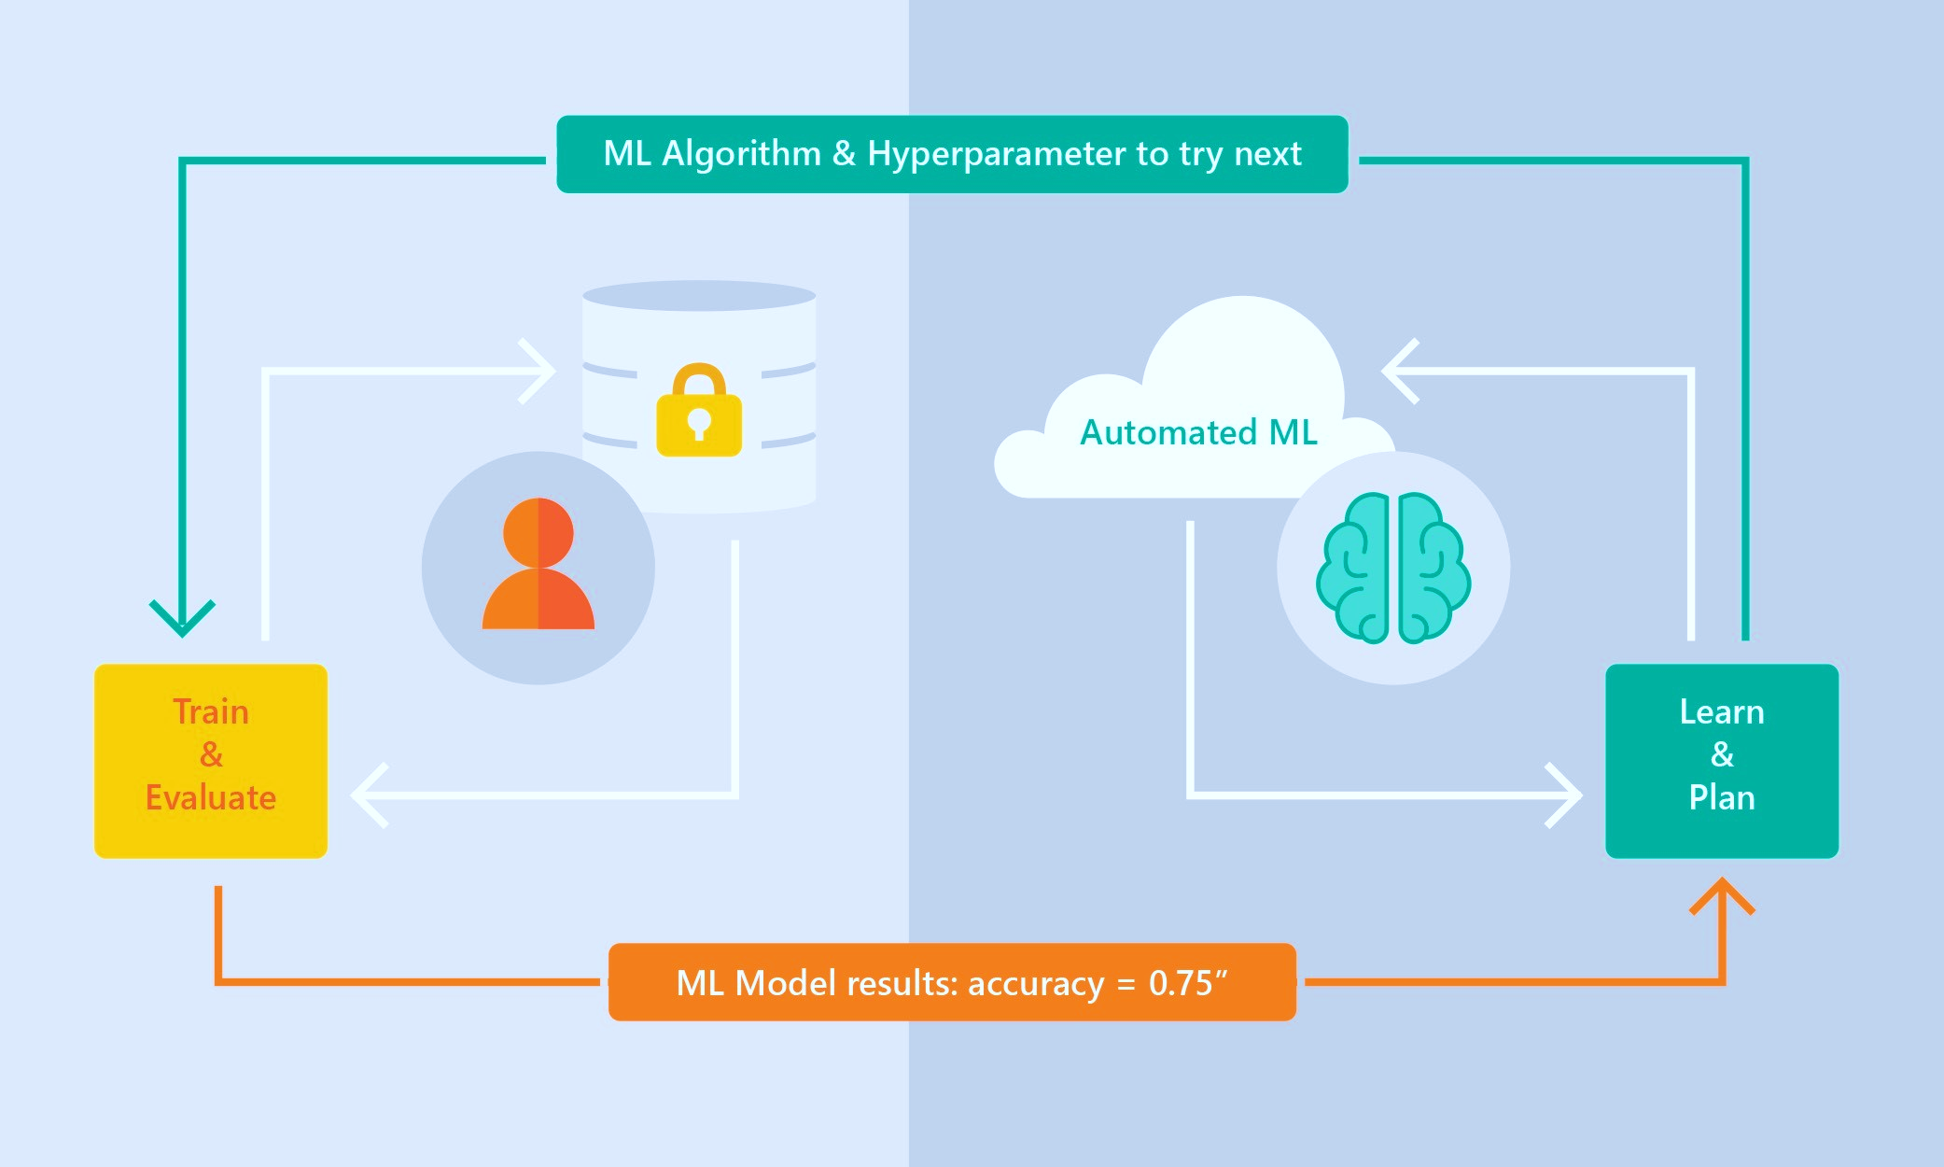
Automated ML Capabilities
Based on Microsoft Research
Brain trained with several million experiments
Collaborative filtering and Bayesian optimization
Privacy preserving: No need to “see” the data

Slide 21
Automated ML Capabilities
ML Scenarios: Classification & Regression, Forecasting
Languages: Python SDK for deployment and hosting for inference – Jupyter notebooks
Training Compute: Local Machine, AML Compute, Data Science Virtual Machine (DSVM), Azure Databricks*
Transparency: View run history, model metrics, explainability*
Scale: Faster model training using multiple cores and parallel experiments
* In Preview

Slide 22




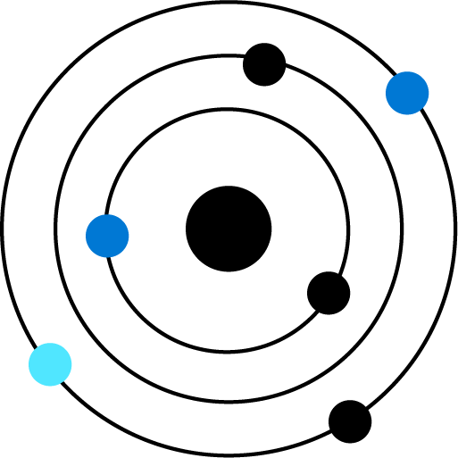

Automated ML
1.
2.
3.
4.
5.
6.
Data Preprocessing
Feature
Engineering
Algorithm
Selection
Hyper-parameter
Tuning
Model Recommendation
Interpretability
& Explaining
Automated ML currently supports automated data cleaning
Most time-consuming part when done manually can now be done within minutes.
Testing many different algorithms at once.
Hyperparameter tuning what to include what to leave out
Having an overview of the best performing models based on accuracy & speed.
Being able to explain what created an outcome and what features had the most significant impact

Slide 23
Guardrails
Class imbalance
Train-Test split, CV, rolling CV
Missing value imputation
Detect high cardinality features
Detect leaky features
Detect overfitting
Model Interpretability / Feature Importance

Slide 24
What’s new?

Slide 25
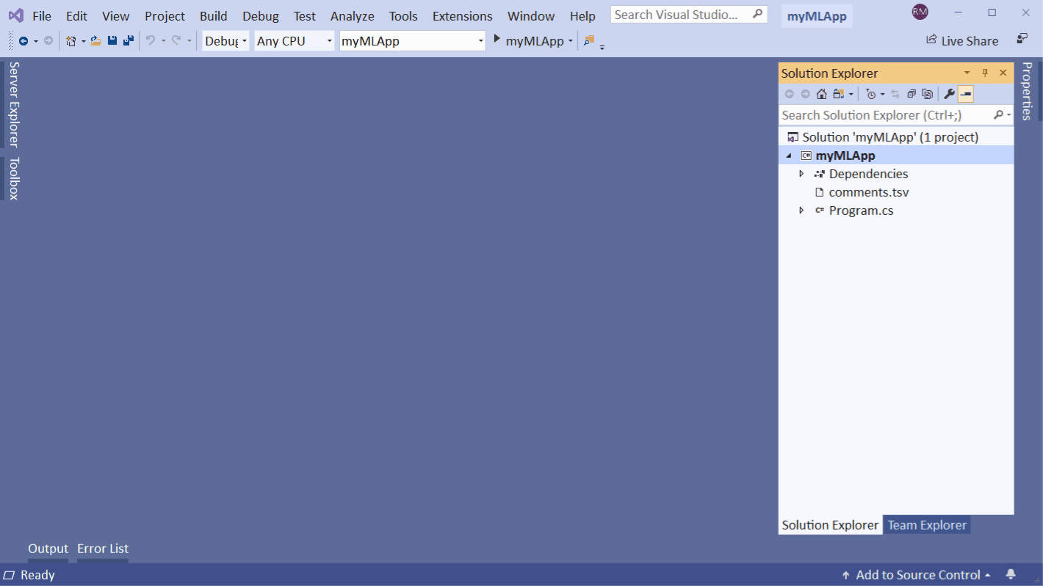
Latest announcements @ MS Build (Blog post with all the announcements)
Automated ML in ML.NET Model Builder (Preview)
Train ML models from Visual Studio
Inference from your application
ML.NET Model Builder

Slide 26
ML.NET AutoML

Slide 27
Automated Machine Learning (AutoML)
Automatically builds models with best performing trainer and settings.
Runs locally and supports three ML tasks (regression, binary classification and multi-classification).
Available in three form factors:
ML.NET CLI (Command Line)
ML.NET Model Builder (Graphical User Interface)
ML.NET AutoML API (Application)

Slide 28
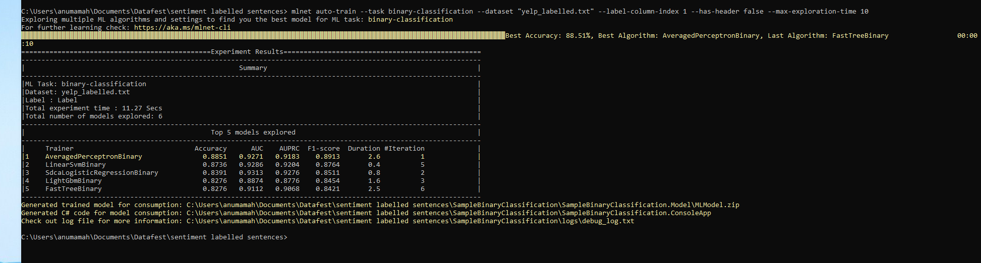
On the command line, with the ML.NET CLI
mlnet auto-train --task binary-classification --dataset "yelp_labelled.txt" --label-column-index 1 --has-header false --max-exploration-time 10

Slide 29
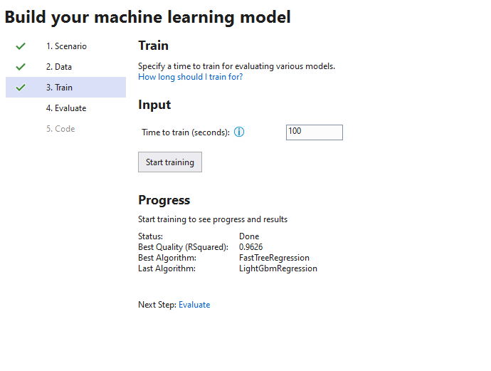
With a graphical user interface, with the the ML.NET Model Builder

Slide 30
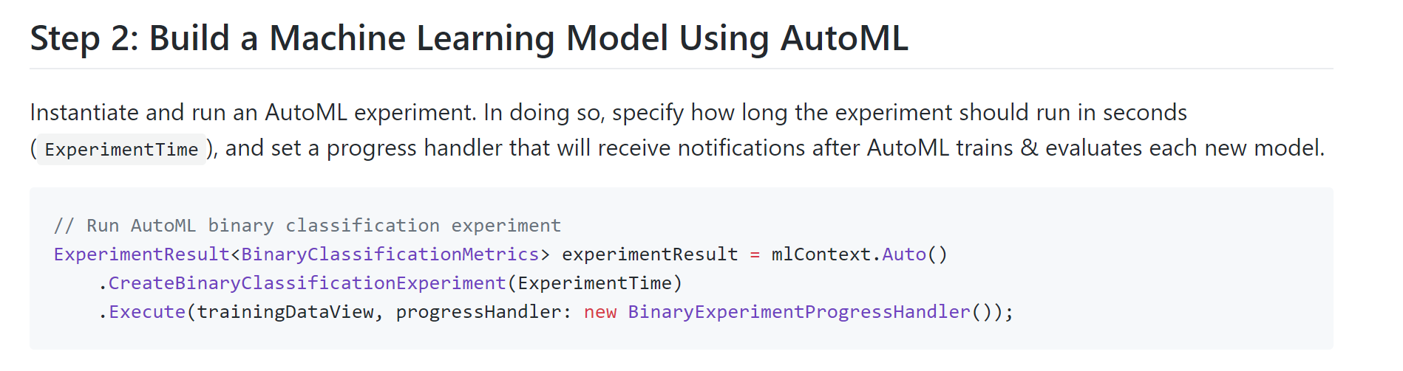
https://github.com/marktab/machinelearning-samples/tree/master/samples/csharp/getting-started/BinaryClassification_AutoML
Via an application, with the automated ML API
Notes:
Same as the cli experience ..but allows you to customize the experiments a bit more..such as blacklisting trainers..selecting a different metric

Slide 31
Automated ML Customer Testimonials
“I quite like your AutoML function. It gives me good results compared to other libraries I tested before (tpot and auto-sklearn) that I believe was only looking at scores and often gave me models that over-trained my data. And of course the model from your suggested code is better.”
- Big oil company
“I will start with AutoML and use the algorithm that AutoML recommends to further tune the model”
- Data Scientist
“I actually enjoy being able to use AutoML in a Jupyter notebook. The DataRobot interface was nice for non-experts, but for someone like me, it felt a bit basic.”
- Data Scientist
Press-coverage from public preview:
CNET
VentureBeat
PRNewswire

Slide 32
Demo: Getting Started with AutoML for ML.NET
Notes:
Installed mlnet
Pointing the PNG
Infer .NET

Slide 33
.NET Advanced Features

Slide 34
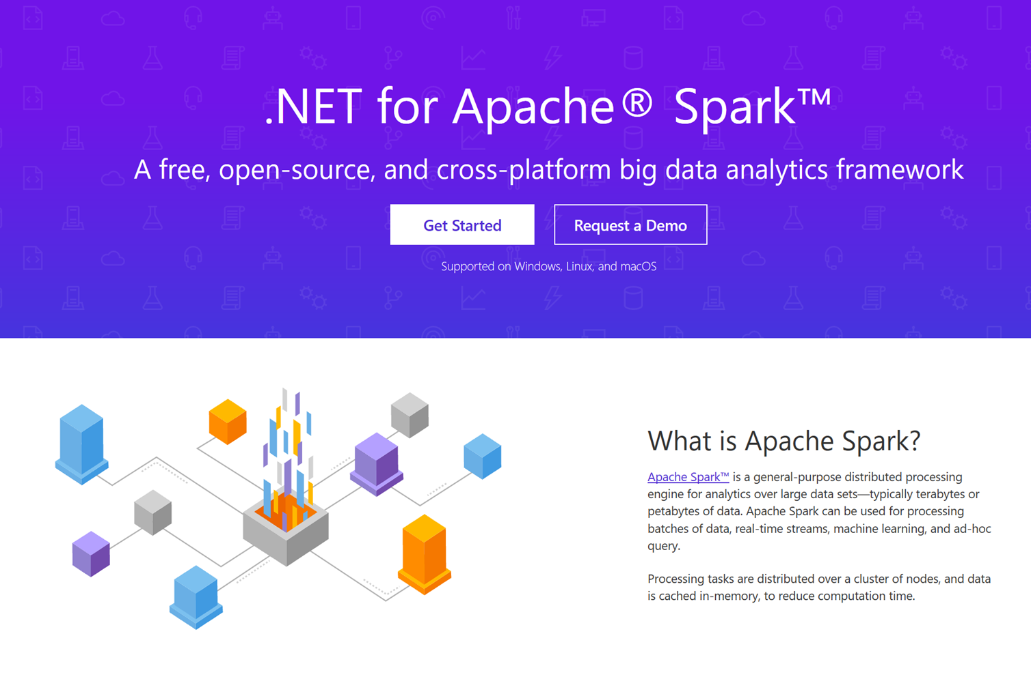
https://dotnet.microsoft.com/apps/data/spark

Slide 35
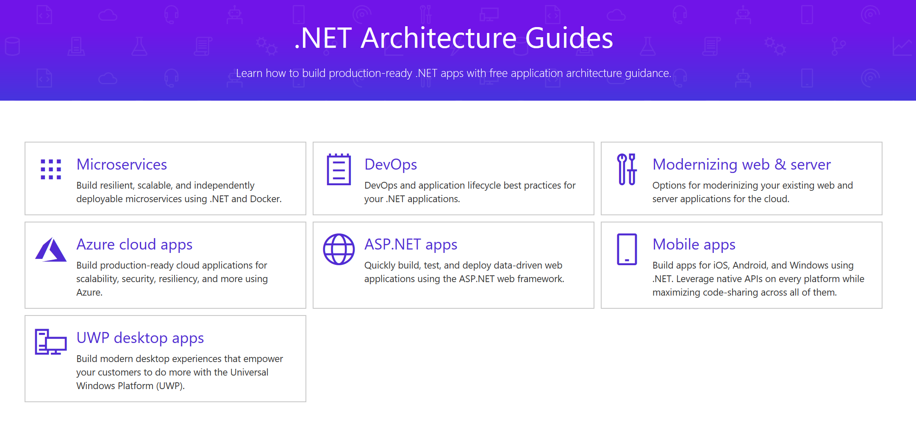
https://dotnet.microsoft.com/learn/dotnet/architecture-guides

Slide 36
ML.NET Action

Slide 37
Action Step: Try ML.NET Today!
Get started at http://dot.net/ml
Try the samples at http://aka.ms/ai-mlnetsamples
Read the docs at http://aka.ms/mlnetdocs
Request features or contribute at http://aka.ms/mlnet

